Slide 1
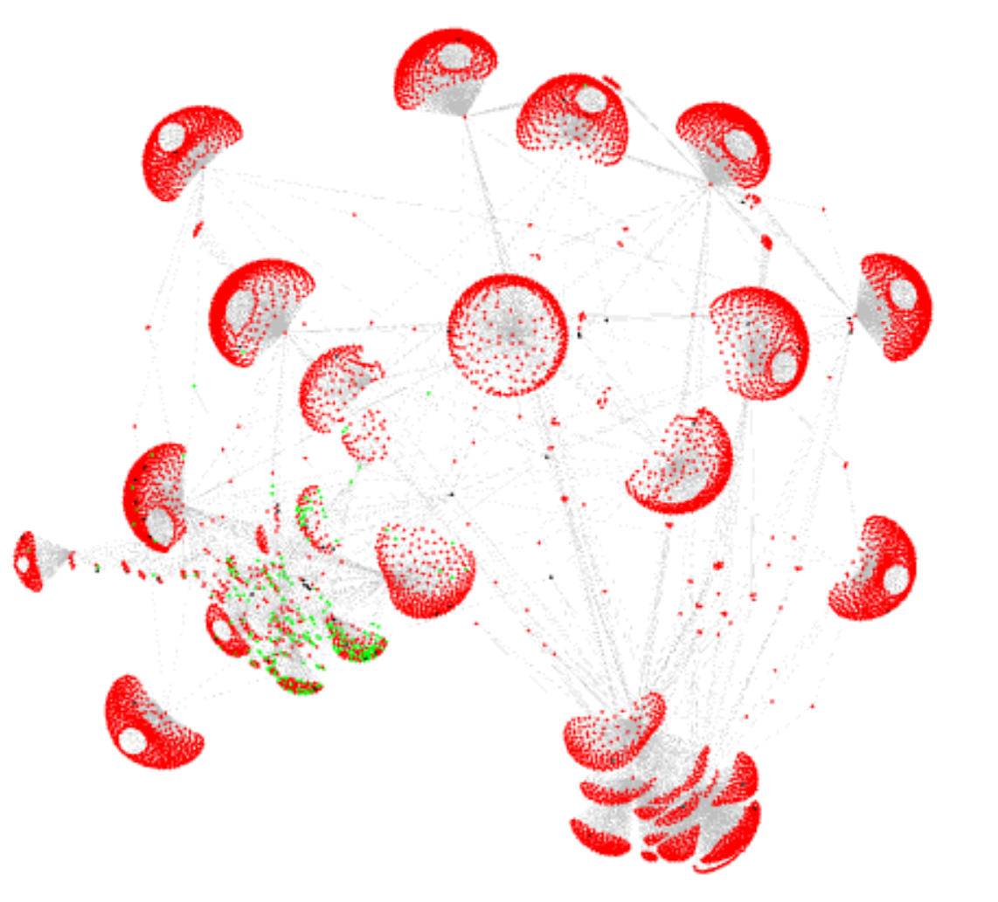
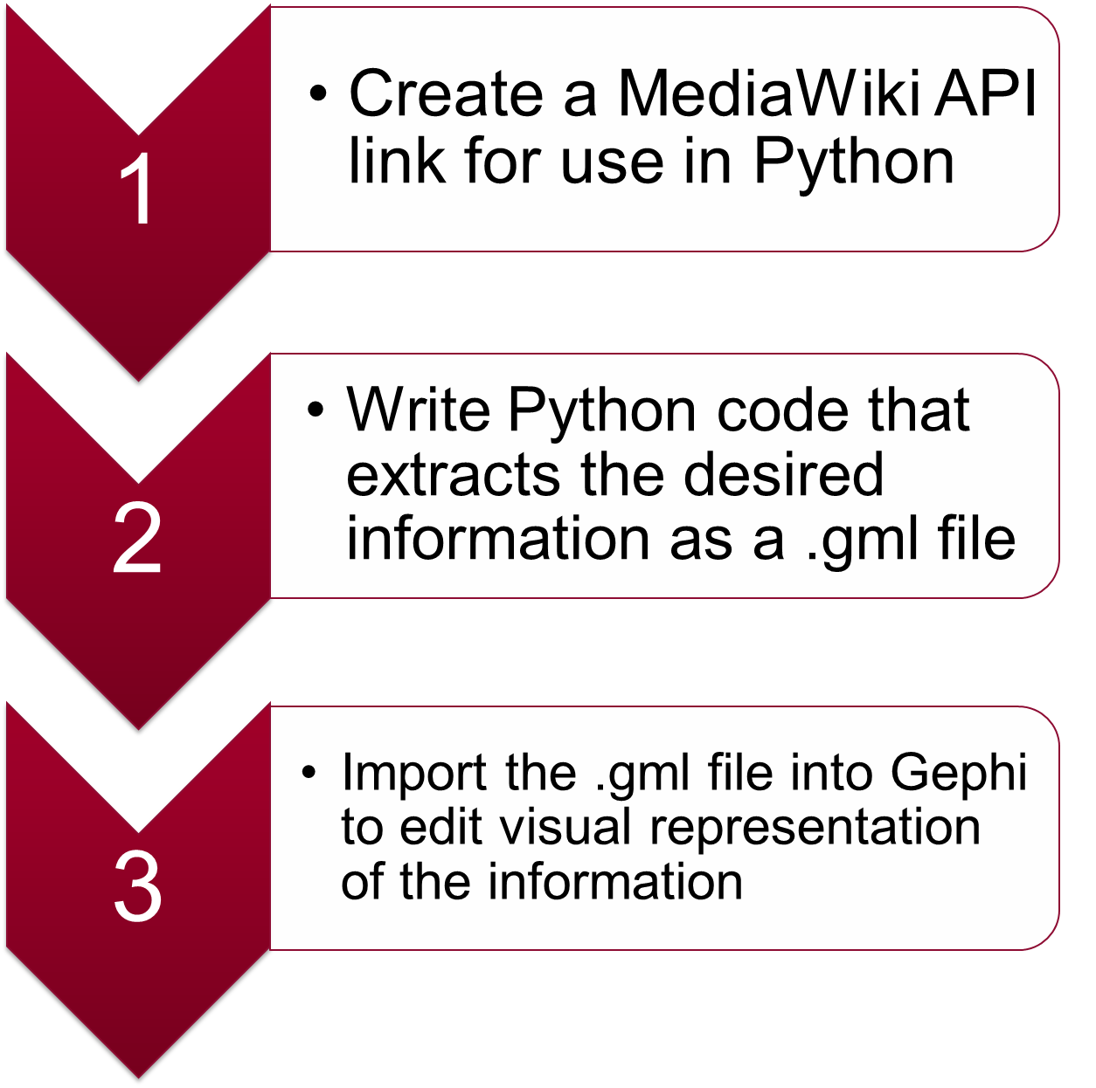
Extracting and Graphing Category Information from a Wikipedia Page
Aman Patel, Indiana University Bloomington
Introduction
Graph of Category Information from Python (programming language)
Discussion
Wikipedia pages contain much more information than what’s shown on the main page. Every article contains text, links, images, categories, and more. In addition, each category of an article contains subcategories, pages, and more categories. All this information can be extracted from a Wikipedia article using MediaWiki API and Python and the information can be graphed using NetworkX and Gephi.
As shown in the graph, most of the nodes were red, meaning most of the titles extracted did not contain the word programming. The average degree of the graph was 2.362, meaning each node has an average of 2.362 edges connecting to it. The diameter of the graph was 4, meaning the pair of nodes that were farthest from each other were 4 nodes apart. The average path length of the graph was 3.871, meaning the average distance between any two nodes was 3.871.
METHOD
References
MediaWiki contributors. “MediaWiki.” MediaWiki, MediaWiki, The Free Wiki Engine, www.mediawiki.org/wiki/MediaWiki.
“NetworkX.” NetworkX - NetworkX, networkx.github.io/.
“The Open Graph Viz Platform.” Gephi, gephi.org/.
How the Graph Was Made
Using the MediaWiki API library, a link was formulated that would display the categories of Python (programming language) in JSON. The link was then processed in Python to create a dictionary of categories. Using NetworkX, a node was created with the title of each category, and the categories were assigned a value of 1 or 0 for a new attribute ‘related’ based on whether it contained the word “programming” in the title. The original URL was edited to find the subcategories of each category, and nodes were created and scanned for each. This process was repeated for the categories and the pages of each category to create the full set of nodes shown in the graph. As each node was created, an edge was added between the new node and its parent node. The graph was written as a .gml file and opened in Gephi. The node color was edited based on the value of ‘related’ and the layout of the graph was changed to Force Atlas. The graph was then expanded to reduce overlap between nodes.
Acknowledgements
Thank you to Mohsen Sayyadiharikandeh, my research mentor. He helped me understand the techniques needed to complete this project and he guided me through every process over the course of the semester.

